Slide 1
SIMPLE SCIENTIFIC CALCULATOR….
PRESENTED BY :
NAME: ROLL NUMBER:
TUSHAR SARIN 1806410116
VIKAS SINGH RATHORE 1806410121

Slide 2





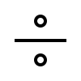

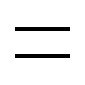

-:TABLE OF CONTENTS:-
> ABSTRACT
> INTRODUCTION
> BASIC FUNCTION
> POCKET CALCULATIONS
> APPLICATION
> REFRENCES

Slide 3

-:ABSTRACT:-
> This project involves in the formation of SCIENTIFIC CALCULATOR using PYTHON 3.7 (32-bit).
> This project work also focused principally on numbers and arithmetic calculations.
> This project will help immensely in the following way :
* Easy calculation of difficult mathematical problems.
* Easy to retrieval of error.
* It will also be of a good assistance to any researchers.

Slide 4
-:INTRODUCTION:-
A scientific calculator is a type of electronic calculator ,designed to calculate problems in any professional fields.
-:MODIFIED FUNCTIONS:
> Scientific notation.
> Floating-point arithmetic.
> Logarithmic functions, using both base 10 and base e.
> Trigonometric functions.
> Exponential functions and root beyond the square root.
> Quick access to constants like ‘pi’ and ‘e’.

Slide 5
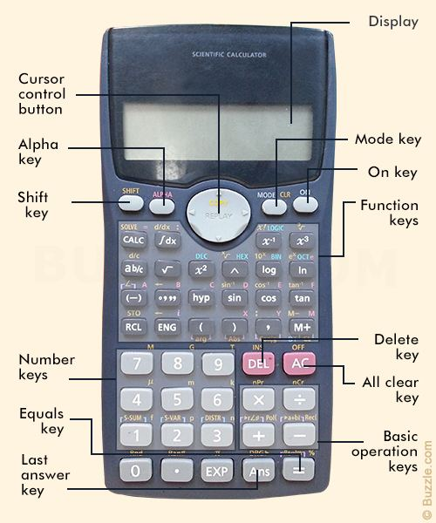
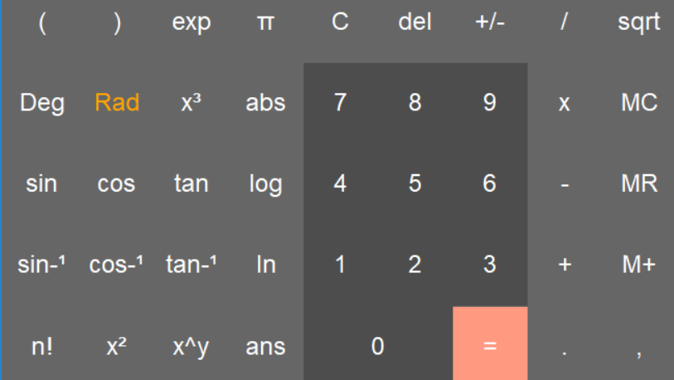
-:BASIC FUNCTIONS:-
> ADDITION
> SUBSTRACTION
> MULTIPLICATION
> DIVISION
> SQUARE
> SQUARE ROOT
> EXPONENT
> LOGARITHM

Slide 6
-:POCKET CALCULATIONS:-
ADDITION :-
> The addition (sum function) is used by clicking on the “+” button or using the keyboard.
> The function results in x + y.
SUBTRACTION :-
> The subtraction (minus function) is used by clicking on the “-” button or using keyboard.
> The function results in x – y.
Division :-
> The division (divide function) is used by clicking on the “/” button or using keyboard.
>The function results in x / y.

Slide 7
-:SQUARE:-
> The square function is used by clicking on the “x^2” button or type “^2”.
-:SQUARE ROOT:-
>The square function is used by clicking on the “sqrt()”.
-:EXPONENT:-
> The exponent (y raised to the power x function) is used by clicking on the “y/x” button or type “^”.
-:LOGARITHM:-
> The logarithm (LOG) is used by clicking on the “LOG” button or type “LOG()”.
> Sin, Cos, Tan, Cosec, Sec, Cot.

Slide 8
-:APPLICATIONS:-
> A calculator helps people perform tasks that involve adding, multiplying, dividing or subtracting numbers.
> Physicists and engineers use scientific calculators, which are much more advanced than standard calculators.
> Accountants and other finance professionals also use specialized calculators, known as financial calculators.

Slide 9
FUTURE SCOPE…
Our project will be able to implement in future after making some changes and modification as we make our project at a very low level.So the modification that can be done in our project are:
To make it screen touch as in our mobile phones so no need to touch key buttons.

Slide 10
-:REFERENCES:-
@ https://en.wikipedia.org/wiki/Scientific_calculator
@ https://www.slideshare.net/anujdrajput/scientific-calculator-using-c

Slide 11
THANKING YOU…

